Slide 1
The Analysis Team
Sprocket Central Pty Ltd
Data analysis approach
ANALYTICS, INFORMATION & MODELING - [Engagement manager], [Senior advisor], Fernanda G Clemente

Slide 2


Schedule
Introduction
Data exploration
Model development
Interpretation

Slide 3


Introduction
Purpose: To boost the business of Sprocket Central Pty Ltd
Problem outline:
Identify and recommend new customers to the Marketing department using previous customer transaction histories and a list of 1,000 potential customers. In order to gain useful customer insights, trends and behaviors, which could help optimize resource allocation for targeted selling and bring greater value to the business.
The approach will be carried out in 3 stages:
Data Exploration;
Model development;
Interpretation;

Slide 4
Data Exploration
Data quality assessment of 1000 potential customers
Data quality issues processed:
GENRE Column – It was verified the existence of 17 lines with U (Without definition of what this category is about). It will not be considered in the analysis.
Column DOB – The column name has been changed to DATE OF BIRTH – It has been verified that there are 17 missing values ​​in the dataset. They will not be considered in the analysis.
AGE GROUP Column – This column was created to analyze how the age range of customers relates to the other attributes of the data set. The age group was created: adolescent > 18 years old, adult I between 18 and 29 years old, adult II between 30 and 39 years old, adult III between 40 and 49 years old, adult IV between 50 and 59 years old and elderly over 60 years old. In addition, the Year column and the Age column were created to be used as auxiliary columns.
JOB column - It was verified that there were 106 missing values ​​in the data set. Will not be considered in the analysis.
LABOR INDUSTRY CATEGORY column - It was verified that there were 165 missing values ​​in the data set. They will not be considered in the analysis.
Columns DEAD INDICATOR, POSSESSION, ADDRESS and COUNTRY – These columns were excluded from the dataset, as they will not be used in the analysis.

Slide 5
Data Exploration
Gender distribution with wealth segmentation and car ownership
Analysis of customers' past transaction history:
The majority target public is made up of women, who made a total of 10,011 purchases in the last 3 years, representing 51.23% of the total of 19,542, while the male public represents 48.77%. Indicating that the focus of Marketing advertisements is more focused on the female gender.
We can also point out that female customers with their own vehicles represent 50.95% of the total of 10,011 bicycles purchased, compared to non-owner customers. Suggesting that owning a vehicle does not influence the decision to make a purchase and that women belonging to the more modest income and wealth segment (Mass Customer) are responsible for the largest number of purchases, representing 51.35% of the total, compared to the other two segments (High Wealth and Affluent Customer), that is, that being in the group with lower liquid assets and an annual income ranging from low to medium does not influence the decision to buy a bicycle.
With regard to the male public, it is important to note that customers who are not vehicle owners make more purchases compared to those who own cars, representing 50.62% of the total of 9,531. In addition, customers belonging to the more modest wealth segment (Mass Customer) are responsible for the largest number of purchases, representing 48.94% of the total of 9,531, following the same trend observed in the female gender.
Table with purchases made in the last 3 years grouped by Gender, Wealth segment and vehicle ownership
Gender | High Net Worth | % | Affluent Customer | % | Mass Customer | % | Grand total | %
Female | 2508 | 25,05% | 2362 | 23,59% | 5141 | 51,35% | 10011 | 51,23%
Owns car – No | 1243 |  | 1069 |  | 2598 |  | 4910 | 49,05%
Owns car – Yes | 1265 |  | 1293 |  | 2543 |  | 5101 | 50,95%
Male | 2464 | 25,85% | 2403 | 25,21% | 4664 | 48,94% | 9531 | 48,77%
Owns car – No | 1217 |  | 1186 |  | 2422 |  | 4825 | 50,62%
Owns car – Yes | 1247 |  | 1217 |  | 2242 |  | 4706 | 49,38%
Grand total | 4972 | 25,44% | 4765 | 24,38% | 9805 | 50,17% | 19542
Note: Lines with empty values, gender U and n/a values ​​were not considered.

Slide 6
Data Exploration
Gender distribution with wealth segmentation and car ownership
Analysis of the 1,000 potential customers using the same methodology as the previous analysis:
The majority target public is made up of women, who made a total of 513 purchases in the last 3 years, representing 52.19% of the total of 983, while the male public represents 47.81%. Indicating that the focus of Marketing advertisements is more focused on the female gender.
We can also point out that female customers with their own vehicles represent 50.88% of the total of 513 bicycles purchased, compared to non-owner customers. Suggesting that owning a vehicle does not influence the decision to make a purchase and that women belonging to the more modest income and wealth segment (Mass Customer) are responsible for the largest number of purchases, representing 51.46% of the total, compared to the other two segments (High Wealth and Affluent Customer), that is, that being in the group with lower liquid assets and an annual income ranging from low to medium does not influence the decision to buy a bicycle.
With regard to the male public, it is important to note that customers who are not vehicle owners make more purchases compared to those who own cars, representing 52.13% of the total of 470. In addition, customers belonging to the more modest wealth segment (Mass Customer) are responsible for the largest number of purchases, representing 50.00% of the total of 470, following the same trend observed in the female gender.
Table with purchases made in the last 3 years grouped by Gender, Wealth segment and vehicle ownership
Gender | High Net Worth | % | Affluent Customer | % | Mass Customer | % | Grand total | %
Female | 136 | 26,51% | 113 | 22,03% | 264 | 51,46% | 513 | 52,19%
Owns car – No | 76 |  | 46 |  | 130 |  | 252 | 49,12%
Owns car – Yes | 60 |  | 67 |  | 134 |  | 261 | 50,88%
Male | 113 | 24,04% | 122 | 25,96% | 235 | 50,00% | 470 | 47,81%
Owns car – No | 61 |  | 66 |  | 118 |  | 245 | 52,13%
Owns car – Yes | 52 |  | 56 |  | 117 |  | 225 | 47,87%
Grand total | 249 | 25,33% | 235 | 23,91% | 499 | 50,76% | 983
Note: Lines with empty values, gender U and n/a values ​​were not considered.

Slide 7
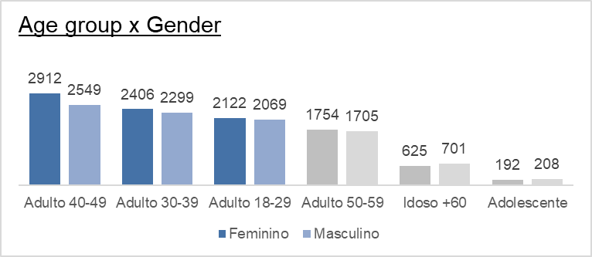
Data Exploration
Age distribution with wealth segmentation and car ownership
Analysis of customers' past transaction history:
The majority target audience is formed by adults between 18 and 49 years old, who made more than 70% of the purchases in the last 3 years, totaling 19,542 purchases, with the age group from 40 to 49 years old buying the most, with 5,461 products purchased, which corresponds to 27.94% of the total.
Furthermore, it is important to note that customers with more modest income and wealth (known as mass customers) are responsible for the largest number of purchases, representing 50.17% (9.805 / 19.542 = 50.17%) of the total of 19,542 compared to the other segments (High Wealth and Affluent Customers).
With regard to the gender of customers, it is observed that the female public is the one that most makes purchases, totaling 10,011 products purchased in various age groups. However, it is important to note that there are exceptions in the Seniors +60 and Teenagers age groups, where the female audience does not lead in number of purchases.
Table with purchases made in the last 3 years grouped by Age Group and Wealth Segment
Age Group | High Net Worth | Affluent Customer | Mass Customer | Grand total | %
Adulto 40-49 | 1453 | 1296 | 2712 | 5461 | 27,94%
Adulto 30-39 | 1192 | 1103 | 2410 | 4705 | 24,08%
Adulto 18-29 | 1031 | 1049 | 2111 | 4191 | 21,45%
Adulto 50-59 | 868 | 883 | 1708 | 3459 | 17,70%
Idoso +60 | 328 | 318 | 680 | 1326 | 6,79%
Adolescente | 100 | 116 | 184 | 400 | 2,05%
Grand total | 4972 | 4765 | 9805 | 19542
Note: Rows with empty values ​​and n/a values ​​were not considered.

Slide 8
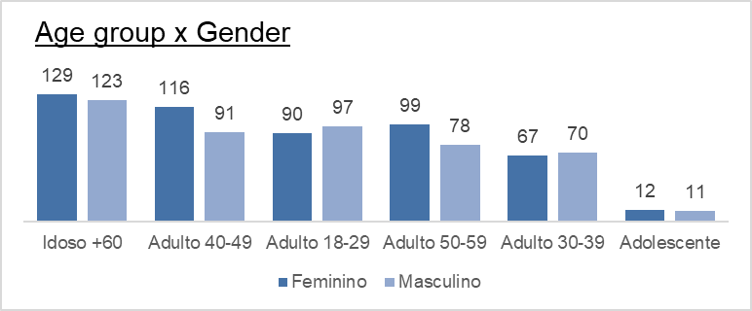
Data Exploration
Age distribution with wealth segmentation and car ownership
Analysis of the 1,000 potential customers using the same methodology as the previous analysis:
The predominant target audience is composed of elderly people over 60 years old, which indicates a possible change from the previous analysis, in which they occupied the penultimate position as regular buyers. In the last 3 years, this group made 25.64% of the purchases of the total of 983. They outperformed the groups of adults aged 40 to 49 and 18 to 29, who occupied the second and third positions, respectively, with 21.06% and 19.02% of total purchases.
In addition, it is important to note that customers with more modest income and equity (Mass Customers), are responsible for the largest number of purchases, representing 50.76% of the total of 983 in relation to the other segments (High Wealth Customers and Affluent). This portion of the population is critical to the success of the business.
Regarding the gender of the customers, it is observed that the female public is the one that makes the most purchases, totaling 513 products purchased in various age groups. However, it is important to note that there are exceptions in the Adult 18-29 and Adult 30-39 age groups, where the female audience does not lead in number of purchases.
Table with purchases made in the last 3 years grouped by Age Group and Wealth Segment
Age Group | High Net Worth | Affluent Customer | Mass Customer | Grand total | %
Idoso +60 | 61 | 59 | 132 | 252 | 25,64%
Adulto 40-49 | 45 | 50 | 112 | 207 | 21,06%
Adulto 18-29 | 52 | 48 | 87 | 187 | 19,02%
Adulto 50-59 | 49 | 40 | 88 | 177 | 18,01%
Adulto 30-39 | 39 | 30 | 68 | 137 | 13,94%
Adolescente | 3 | 8 | 12 | 23 | 2,34%
Grand total | 249 | 235 | 499 | 983
Note: Rows with empty values ​​and n/a values ​​were not considered.

Slide 9
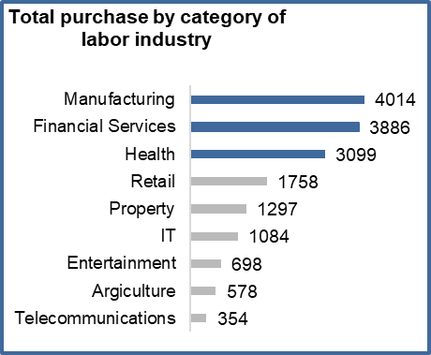
Data Exploration
Distribution by Job Title and Work Industry Category
Analysis of customers' past transaction history:
First, it is important to note that the amount of missing data in the attributes of Category Industry of work and Positions directly affects the analysis in terms of quantity sold, which makes it difficult for the consumer to identify a trend.
Based on the data provided and excluding the missing information in the analysis, we can see that the top three sectors in terms of quantity of purchases are Manufacturing, Financial Services and Healthcare. The manufacturing industry is the one that buys the most, representing 23.94% of the total of 16,768 transactions (20,000 - 3,232).
Regarding the positions, it is observed that the differences between the top 10 positions in terms of quantity of purchases are very small. The position of Social Worker is the one that buys the most, representing 10.82% of the total of 2,088 (calculated as the difference between 4,485 and 2,397). These values represent the total of the top 10 positions.
Industrial Category | Purchases | %
Manufacturing | 4014 | 20,07%
Financial Services | 3886 | 19,43%
(n/a) | 3232 | 16,16%
Health | 3099 | 15,50%
Retail | 1758 | 8,79%
Property | 1297 | 6,49%
IT | 1084 | 5,42%
Entertainment | 698 | 3,49%
Argiculture | 578 | 2,89%
Telecommunications | 354 | 1,77%
Industrial Category | Purchases | %
Manufacturing | 4014 | 23,94%
Financial Services | 3886 | 23,18%
Health | 3099 | 18,48%
Retail | 1758 | 10,48%
Property | 1297 | 7,73%
IT | 1084 | 6,46%
Entertainment | 698 | 4,16%
Argiculture | 578 | 3,45%
Telecommunications | 354 | 2,11%
Grand total | 16.768
The first 10 job titles in terms of quantity of purchases
Job Title | Purchases | %
(n/a) | 2397
Social Worker | 226 | 10,82%
Legal Assistant | 221 | 10,58%
Business Systems Development Analyst | 221 | 10,58%
Assistant Professor | 212 | 10,15%
Executive Secretary | 208 | 9,96%
Internal Auditor | 207 | 9,91%
Nuclear Power Engineer | 205 | 9,82%
Tax Accountant | 197 | 9,43%
Administrative Officer | 196 | 9,39%
Chemical Engineer | 195 | 9,34%
Grand total | 4485 (2.088)
Total = 4.485 – 2.397 = 2.088 Ex.: 226 / 2.088 = 10,82%

Slide 10
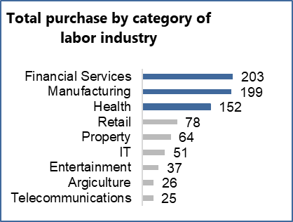
Data Exploration
Distribution by Job Title and Work Industry Category
Analysis of the 1,000 potential customers using the same methodology as the previous analysis:
First, it is important to note that the amount of missing data in the attributes of Category Industry of Work and Title of positions directly affects the analysis in terms of quantity sold, which makes it difficult for the consumer to identify a trend.
Based on the data provided and excluding the missing information in the analysis, we can see that the top three sectors in terms of quantity of purchases are Manufacturing, Financial Services and Healthcare. The same sectors of the previous analysis, with financial services becoming the sector that buys the most, representing 24.31% of the total of 835 transactions (1,000 - 165 = 835).
In relation to job titles, it is observed that the differences between the first 10 job titles in terms of quantity of purchases are very small, equal to the previous analysis. The title of assistant professor is the one that buys the most, representing 12.93% of the total of 222 (calculated as the difference between 1,000 and 106).
Industrial Category | Purchases | %
Financial Services | 203 | 20,30%
Manufacturing | 199 | 19,90%
(n/a) | 165 | 16,50%
Health | 152 | 15,20%
Retail | 78 | 7,80%
Property | 64 | 6,40%
IT | 51 | 5,10%
Entertainment | 37 | 3,70%
Argiculture | 26 | 2,60%
Telecommunications | 25 | 2,50%
Grand total | 1.000
The first 10 job titles in terms of quantity of purchases
Job Title | Purchases | %
(n/a) | 106
Associate Professor | 15 | 12,93%
Environmental Tech | 14 | 12,07%
Software Consultant | 14 | 12,07%
Chief Design Engineer | 13 | 11,21%
Assistant Media Planner | 12 | 10,34%
Cost Accountant | 12 | 10,34%
VP Sales | 12 | 10,34%
Assistant Manager | 12 | 10,34%
Senior Sales Associate | 12 | 10,34%
Grand total | 222
Total = 222 – 106 = 116 Ex.: 15 / 116 = 12,93%
Industrial Category | Purchases | %
Financial Services | 203 | 24,31%
Manufacturing | 199 | 23,83%
Health | 152 | 18,20%
Retail | 78 | 9,34%
Property | 64 | 7,66%
IT | 51 | 6,11%
Entertainment | 37 | 4,43%
Argiculture | 26 | 3,11%
Telecommunications | 25 | 2,99%
Grand total | 835
Total = 1.000 – 165 = 835 Ex.: 203/835 = 24,31%

Slide 11
Data Exploration
Breakdown by State
Analysis of customers' past transaction history:
The first 10 postal codes of the NSW State
Postal Code | Purchase | Condado
2153 | 169 | Richmond
2170 | 140 | Campbelltown
2770 | 146 | Penrith
2763 | 125 | Richmond
2065 | 117 | Chatswood
2155 | 136 | Richmond
2145 | 125 | Richmond
2147 | 106 | Richmond
2760 | 112 | Penrith
2261 | 109 | Pymble
Grand Total | 1.285
The largest buyers of bicycles and accessories in Australia are located in the state of New South Wales (NSW), accounting for 53.51% of a total of 19,968 purchases made in the last 3 years. Thus, they become the target audience of the analysis. The remaining buyers are found in the state of Queensland (QLD) with 25.15% and Victoria (VIC) with 21.34% of the purchases.
Furthermore, when analyzing the top 10 largest buyers in the state of NSW, identified through their postal codes, we can see the predominance of Richmond County with 51.31% of the purchases, followed by Penrith and Campbelltown counties with 19.36% and 10.99% respectively, out of a total of 1,285.
Condado | Purchase | %
Richmond | 661 | 51,31%
Campbelltown | 140 | 10,99%
Penrith | 258 | 19,36%
Chatswood | 117 | 10,35%
Pymble | 109 | 7,99%
Grand Total | 1.285
Note: Rows with empty values ​​and n/a values ​​were not considered.

Slide 12
Data Exploration
Breakdown by State
Analysis of the 1,000 potential customers using the same methodology as the previous analysis:
The first 10 postal codes of the NSW State
Postal Code | Purchase | Condado
2232 | 9 | Illawarra
2145 | 9 | Richmond
2750 | 7 | Penrith
2148 | 7 | Richmond
2168 | 7 | Campbelltown
2560 | 6 | Campbelltown
2770 | 6 | Penrith
2121 | 6 | Gosford
2170 | 6 | Campbelltown
2026 | 6 | Bondi
2066 | 6 | Chatswood
Grand Total | 75
As in the previous analysis, the target audience, comprising the largest buyers of bicycles and accessories in Australia, continues to be predominantly located in the state of New South Wales (NSW), representing 50.60% of the total 1000 purchases made in the last 3 years.
Upon analyzing the top 10 buyers in NSW based on their postcodes, we have identified the predominance of Campbelltown County, which accounted for 25.33% of the purchases. Following closely are the counties of Richmond and Penrith, representing 21.33% and 17.33% respectively, out of a total of 75 purchases made in this region.
Condado | Purchase | %
Campbelltown | 19 | 25,33%
Richmond | 16 | 21,33%
Penrith | 13 | 17,33%
Illawarra | 9 | 12,00%
Gosford | 6 | 8,00%
Bondi | 6 | 8,00%
Chatswood | 6 | 8,00%
Grand Total | 75
Note: Rows with empty values ​​and n/a values ​​were not considered.

Slide 13
Model development
Development of a customer model
Customer Discovery (Audience identified based on customer transaction history)
Feminine gender (51.23%)
Wealth segment: Mass Customer (50,17%)
Age range 18 to 49 with predominance for the range 40-49 (27,94%)
Labor sector category: Manufacturing, Financial Services and Health with a predominance for Manufacturing (23,94%)
State New South Wales (53,51%)
Condado de NSW: Richmond, Campbelltown and Penrith with predominance for Richmond (51,31%)
Customer Validation (Audience identified based on 1000 potential customers)
Feminine gender (52,19%)
Wealth segment: Mass Customer (50,76%)
Predominant age group is Idoso 60+ with 25.64%, followed by Adulto 40-49 (21.06%) and Adulto 18-29 (19.02%). The only attribute that differed from the previous analysis, but the 40-49 age group, in general terms, continues to be the biggest buyer of the product.
Labor sector category: Manufacturing, Financial Services and Health with a predominance for Financial Services (24,31%)
State New South Wales (50,60%)
Condado de NSW: Richmond, Campbelltown and Penrith with predominance for Campbelltown (25,33%)
Customer Discovery |  | Customer transaction history | 1.000 potential customers
Gender | Female | 51,23% | 52,19%
 | Male | 48,77% | 47,81%
Wealth segment | High Net Worth | 25,44% | 25,33%
 | Affluent Customer | 24,38% | 23,91%
 | Mass Customer | 50,17% | 50,76%
Age Group | Adolescente | 2,05% | 2,34%
 | Adulto 18-29 | 21,45% | 19,02%
 | Adulto 30-39 | 24,08% | 13,94%
 | Adulto 40-49 | 27,94% | 21,06%
 | Adulto 50-59 | 17,70% | 18,01%
 | Idoso +60 | 6,79% | 25,64%
Industrial Category | Manufacturing | 23,94% | 23,83%
 | Financial Services | 23,18% | 24,31%
 | Health | 18,48% | 18,20%
State | NSW | 53,51% | 50,60%
 | QLD | 21,34% | 22,80%
 | VIC | 25,15% | 26,60%
Condado | Campbelltown | 10,99% | 25,33%
 | Richmond | 51,31% | 21,33%
 | Penrith | 19,36% | 17,33%

Slide 14
Interpretation
Customer Creation
Demographic profile: The target audience is made up of women in their 40s, a stage in life when they can have more financial control and want to prioritize their health and well-being. They are likely to be well established in their careers and have the means to invest in recreational activities and products such as bicycles and accessories.
Geographic focus: Focusing on Richmond, Campbelltown and Penrith counties of New South Wales allows you to target a specific local market. This suggests that it can capitalize on the stores' proximity to these areas and engage potential customers through localized marketing efforts.
Customization Opportunities: With a narrower target audience, you'll have the opportunity to tailor your marketing messages, product offerings and customer experiences to specifically address the preferences and lifestyles of women in this age group. Personalization can help build stronger connections and foster loyalty among your target customers.
Industry Relevance: By focusing on the Manufacturing, Financial Services and Healthcare sectors, you can align your marketing strategies with your audience's interests and needs. For example, emphasizing the health benefits of cycling, promoting stress relief through outdoor activities, or providing flexible payment options that suit your financial circumstances.
Potential Influencers: Considering the demographics and work sectors of the target audience, it may be beneficial to explore partnerships or collaborations with local influencers, community leaders or organizations in these sectors. Leveraging influence and credibility can help reach a wider audience within your target audience.

Slide 15

Any questions,
please inform.
Thanks!

